Slide 1
(Research Project Title) Project Coordinator Name： MSL Faculties：
Laboratory for Materials and Structures, Collaborative Research Projects No.○○(adoption number)
International CRP 2019－Category A, B or C
- Aims of Research -
Arial 10-14
- Results -
Arial 10-14
Please fill information such as URLs, research papers, etc., which you wish to publicize, in this section.

Slide 2
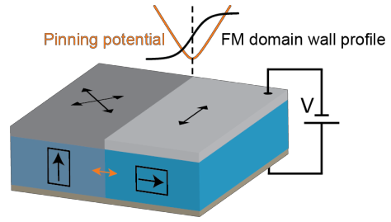
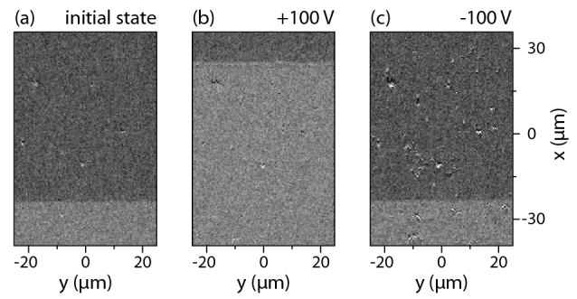
International CRP 20XX－Category A
Laboratory for Materials and Structures, Collaborative Research Projects No.○○(adoption number)
Electric-field control of Ferromagnetic domain and domain walls
Project Coordinator Name： Sebastiaan van Dijken (Aalto University)
MSL Faculties： Tomoyasu Taniyama
Aims of Research -
The project aims to elucidate the physics behind strain-coupled ferromagnetic-ferroelectric domains in multiferroic heterostructures. In particular, the ability to drive magnetic domain walls by an electric field without assistance of a magnetic field or spin-polarized current will be demonstrated and assessed. This new driving mechanism will provide a low-power alternative for the design of spintronic devices.
Results -
Reversible magnetic domain wall motion purely driven by electric fields is achieved in 20 nm thick Fe films that are epitaxially grown onto ferroelectric single-crystal BaTiO₃ substrates using molecular beam epitaxy. The tetragonal BaTiO₃ substrates consist of alternating domains with in-plane (a- domain) and out-of-plane (c-domain) polarization. An out-of-plane electric field laterally moves the ferroelectric boundary between the a- and c-domains. This effect displaces the magnetic domain wall in the Fe film that is elastically pinned onto the ferroelectric boundary.
Sample
Web page: http://physics.aalto.fi/groups/nanospin/

